Slide 1
Event name or presentation title
Subtitle or speaker name

Slide 2
Event name or presentation title
Subtitle or speaker name

Slide 3
Text layout (without bullet points)
Main topic: Segoe UI Semilight, size 28pt
Segoe UI, size 20pt for second level
Segoe UI, size 16pt for third level

Slide 4
Text layout with bulleted text
Main topic: Segoe UI Semilight, size 28pt
Segoe UI, size 20pt for second level
Segoe UI, size 16pt for third level

Slide 5
Example with longer headline text wrapping to a second line
When the headline text is 2 lines, move this text block down to align to the lower blue guide
If you don’t see guidelines, click on the View menu, and then check the box in front of “Guides”
Use a “soft return” Shift + Enter to wrap text without adding extra line spacing

Slide 6
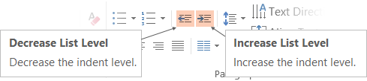
Adjusting list levels
Main topic: Segoe UI Semilight, size 28pt
Segoe UI, size 20pt for second level
Segoe UI, size 16pt for third level
Use the “Decrease List Level” and “Increase List Level” tools on the Home menu to change text levels.
Try this:
Place your cursor in the line of text that says “Segoe UI, size 20pt for second level”
Next click the Home tab, and then on the “Decrease List level” tool. Notice how the line moves up one level.
Now try placing your cursor in one of the top “Main topic…” line of text. Click the “Increase List Level” tool and see how the text is pushed in one level.
Use these 2 tools to adjust your text levels as you work

Slide 7
Bullet points layout with subtitle Set the subtitle to 20pt in the same text block, with character spacing Normal
Move the text block down vertically to align to lower guide
If you don’t see guidelines, click on the View menu, and then check the box in front of “Guides”
Hyperlink style: www.microsoft.com

Slide 8
Demo
Speaker name

Slide 9
Video

Slide 10
Section title

Slide 11
Software code slide
This slide layout uses Consolas, a monotype font which is ideal for showing software code.

Slide 12
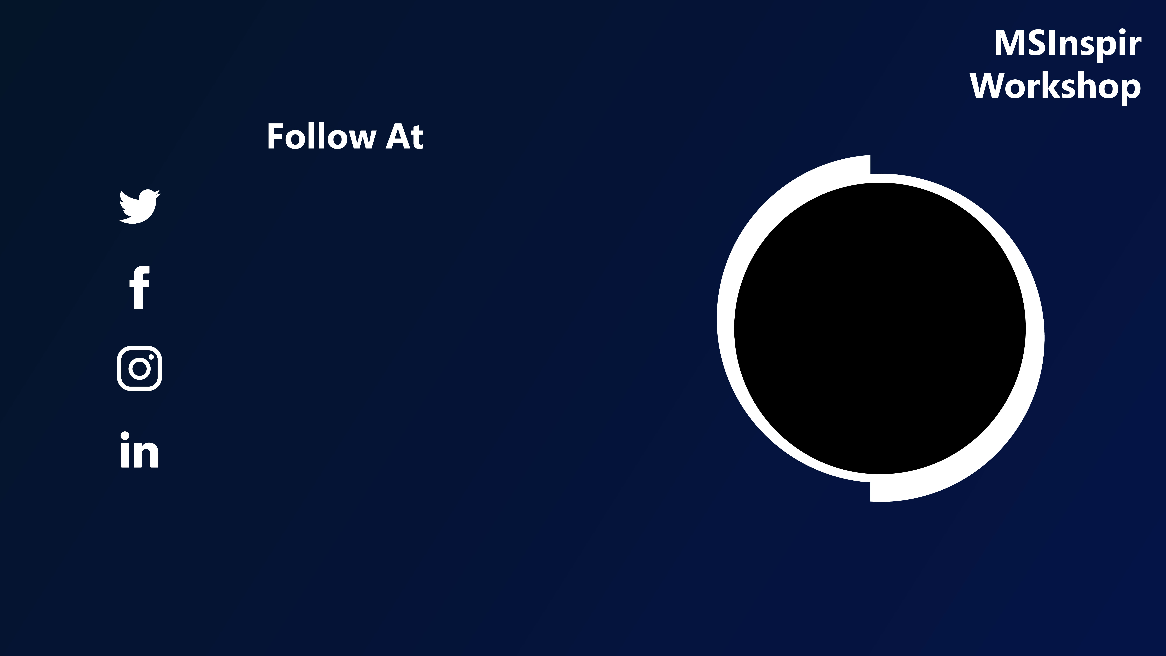
Twitter Handle
To Add Image
-Right Click on this Circle.
-Go to Format Shape.
-Insert your Image using “Picture or Texture Fill” Option from the Shape Options.
Facebook Handle
Instagram Handle
LinkedIn Handle

Slide 13


